Slide 1
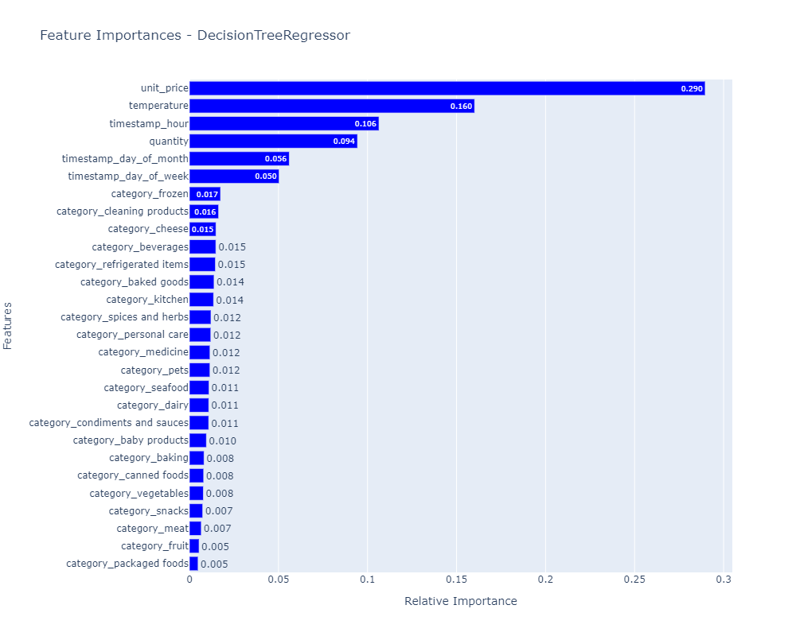
Certainly, it is possible to make precise predictions regarding product stock levels by leveraging both sales data and sensor data on an hourly basis. This capability allows for more strategic and informed procurement of products from our suppliers.
Analyzing the provided plot reveals that unit_price, temperature, and timestamp_hour are the three most influential features affecting the estimated_stock_pct. Specifically, the Relative Importance of unit_price is 28.7%, temperature is 16.2%, and timestamp_hour is 11.1%. These Relative Importance scores signify the extent to which each feature influences the selected target variable, in this case, estimated_stock_pct. Consequently, we can conclude that unit_price, temperature, and timestamp_hour indeed have a discernible impact on the estimated_stock_pct.

Slide 2
